Slide 1
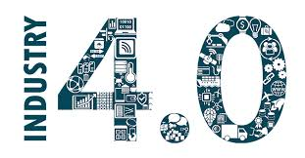
بِسْمِ اللهِ الرَّحْمٰنِ الرَّحِيْمِ “
In the name of Allah, the Most Gracious, the Most Merciful
Contemporary Learning Session
4th IR and It’s Implication in Research
Md. Imam Sohel Hossain
Senior Scientific Officer
Leather Research Institute
Bangladesh Council of Scientific and industrial Research (BCSIR)

Slide 2
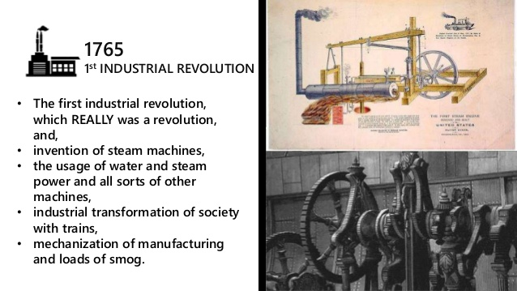
First IR

Slide 3
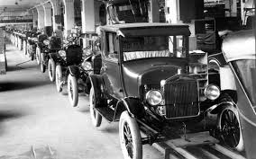
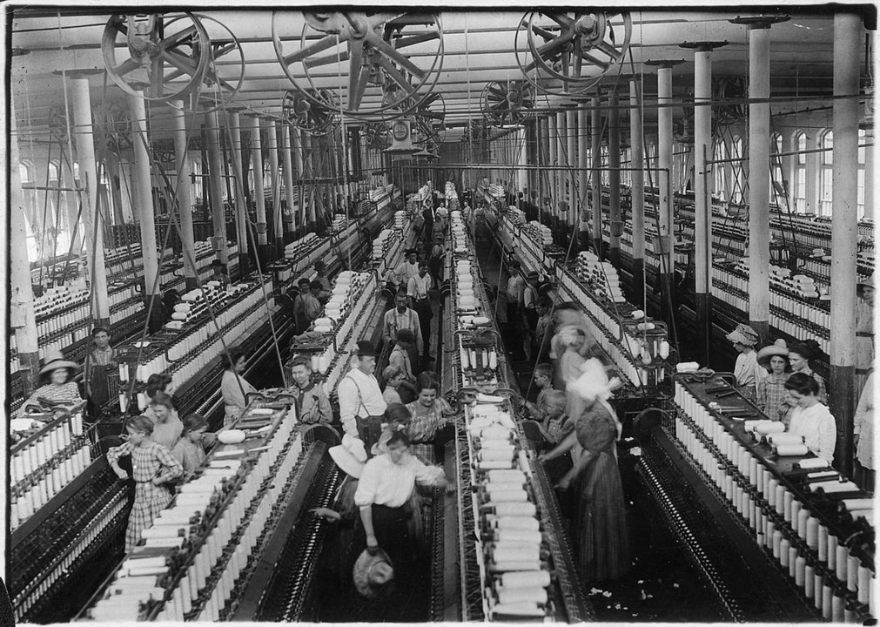
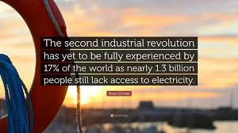
Second IR
36 sec to assemble a car

Slide 4
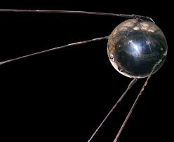
Spinoff of Cold/Space War

Slide 5
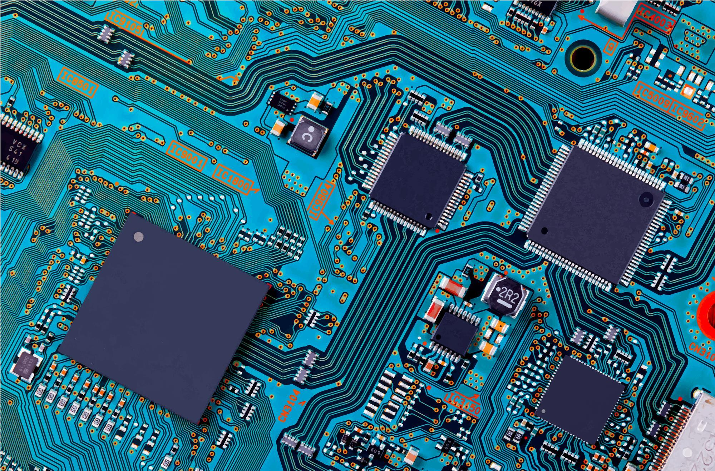
3rd IR- Microcomputer/Microchip

Slide 6
Space Age
There are two events in human history that drive technology and medicine forward.
War, and the Space Race. The Space Race was a diversion of wartime technology during the Cold War between the United States and the Soviet Union.
Both were smart enough to not want to prove their capability of accurately launching nuclear missiles toward each other by actually launching nuclear missiles.
Instead both sides set out to prove that our rocket technology (which “wink wink” could also be used to deliver nuclear bombs if we wanted to) was bigger and better than the other.
The race to the moon drove forward tremendous advances in solid state electronics and micro circuitry, materials, communications, computer science, solar energy, robotics, artificial intelligence medicine.
There is hardly a science, technology or industry that was not involved in some way by the space race.
You can type in “Spin offs of space exploration” for a list of the thousands of products we use today traceable directly back to the space program. This is why space exploration continues today.

Slide 7
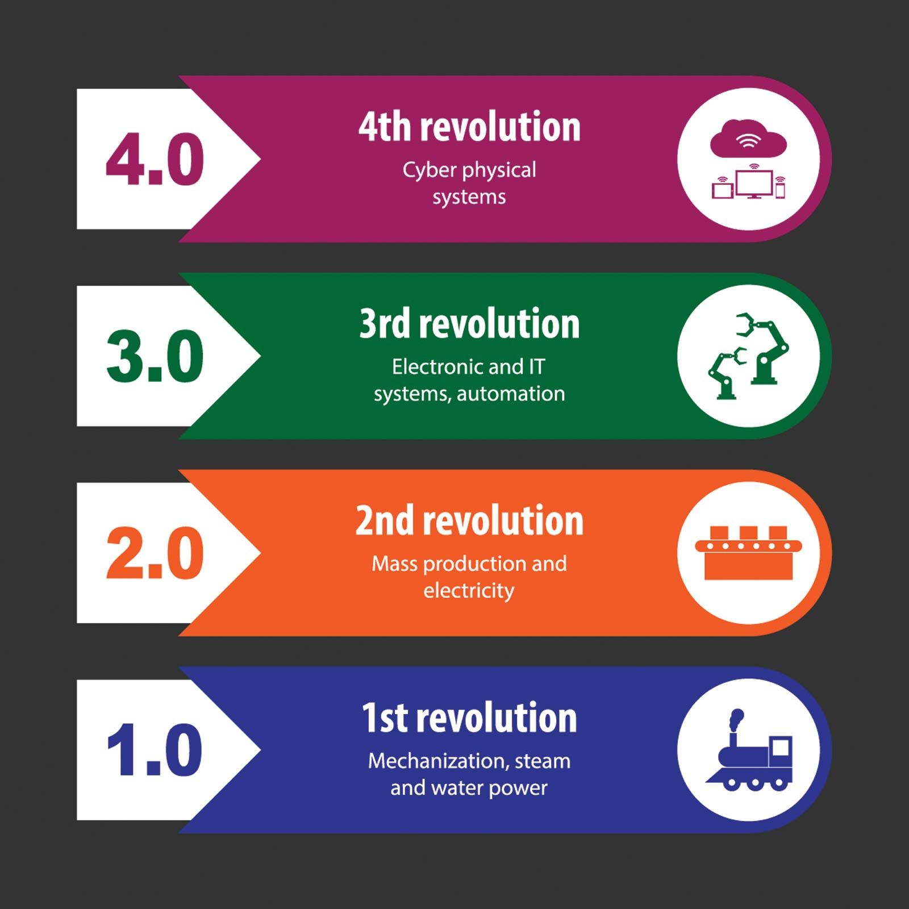
Incredible adventure story
Imagine it's the late 1700s, and people mostly work on farms or in small workshops. Then, something amazing happens: inventors create machines that can do work faster and easier than people ever could. This is the First Industrial Revolution, and it starts with machines powered by water and steam. Factories pop up, and people move to cities to work.

Slide 8
Incredible adventure story continues to 2nd IR
Fast forward to the late 1800s and early 1900s, and we enter the Second Industrial Revolution. Now, electricity powers machines, and new inventions like the telephone and the automobile change how we live and connect with each other.

Slide 9
Incredible adventure story continues to 3rd IR
Next, we jump to the mid-20th century for the Third Industrial Revolution, where computers and electronics come into play. Factories become more advanced with robots, and the internet starts to link people around the world.

Slide 10
Incredible adventure story continues to 4th IR
Finally, we reach the Fourth Industrial Revolution, where things get even more futuristic. Imagine robots that think, cars that drive themselves, and smart devices that can talk to each other. This revolution is all about blending digital technology with the physical world, using artificial intelligence, big data, and the Internet of Things to create a world that's more connected and efficient than ever before. Each revolution builds on the previous one, making our world more advanced and exciting.

Slide 11
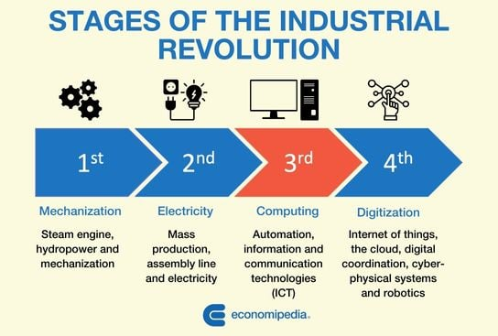

Slide 12
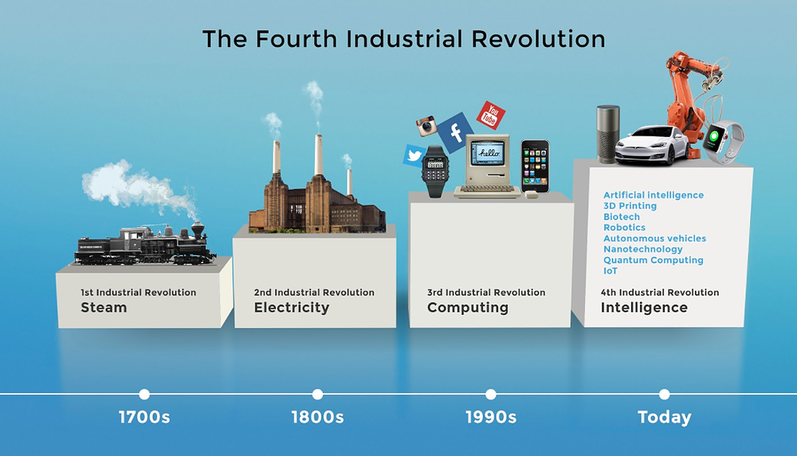

Slide 13

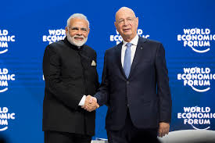
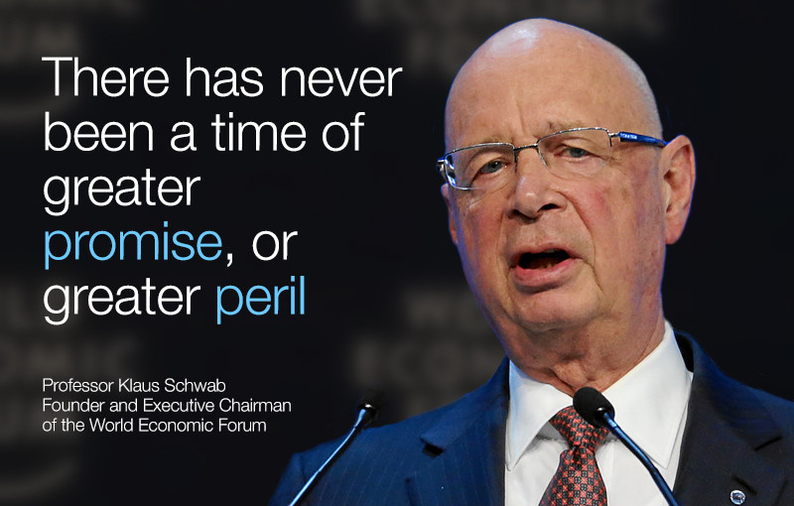
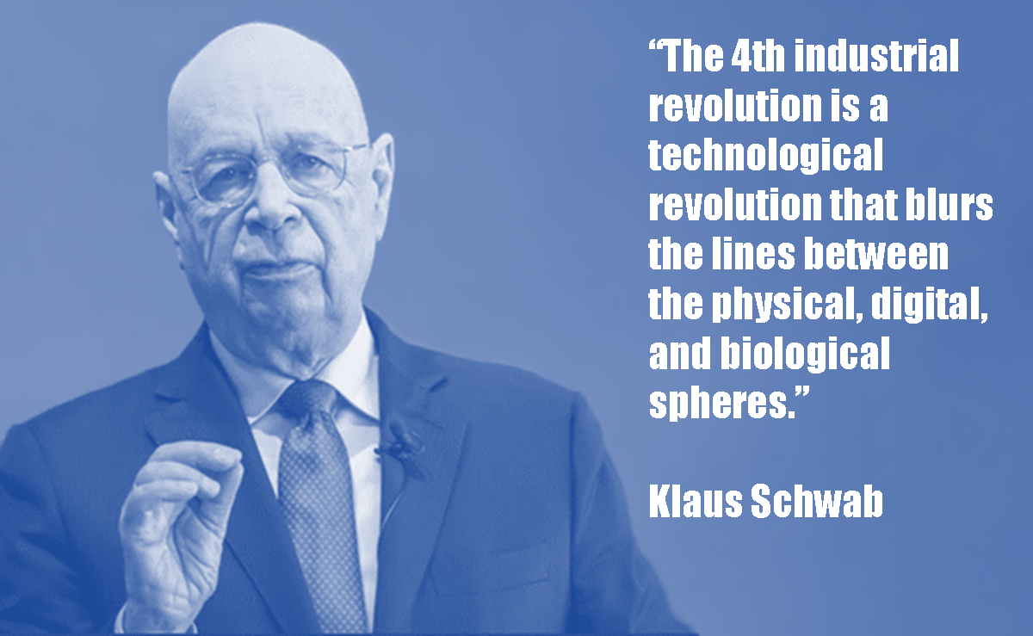

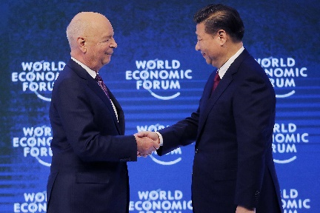
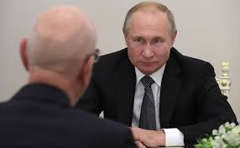

Slide 14
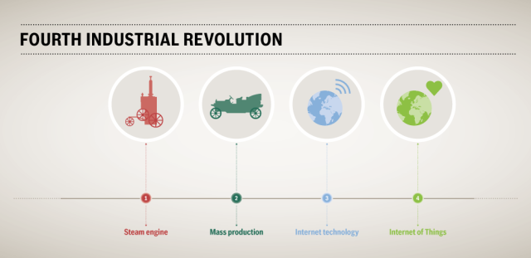

Slide 15
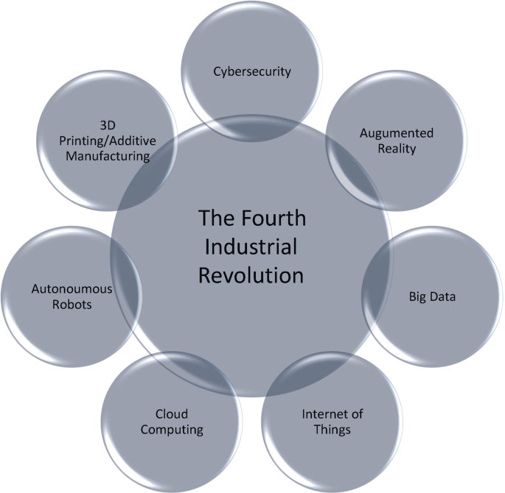
Components of 4th IR

Slide 16
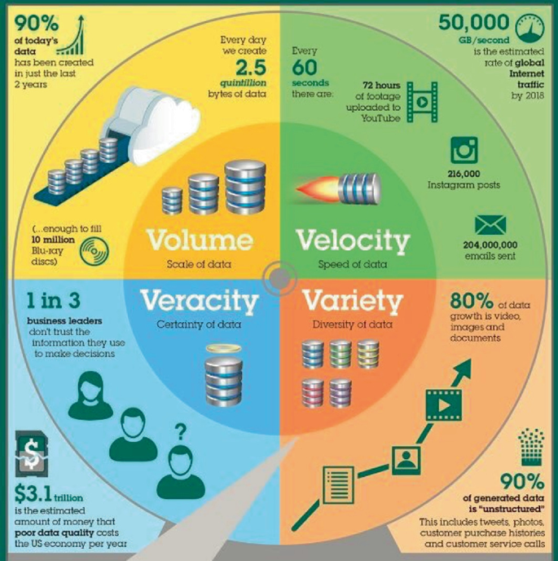
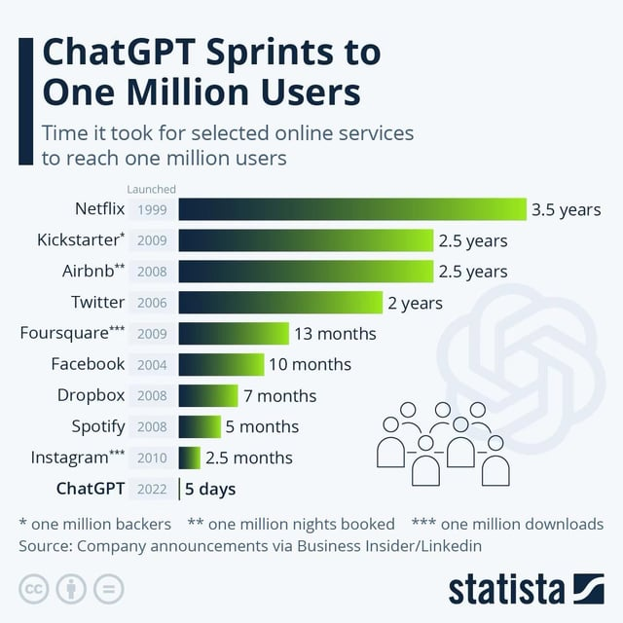
Characteristics of 4th IR

Slide 17
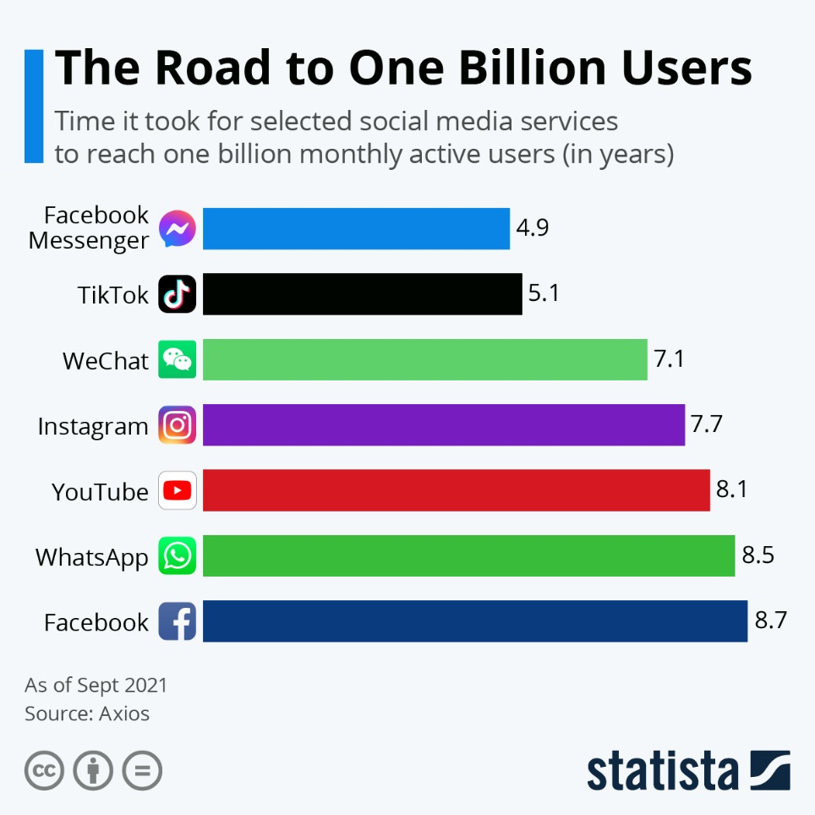
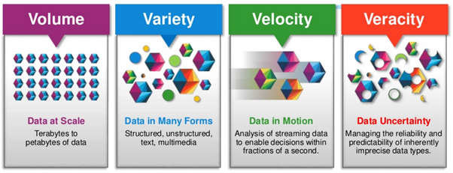
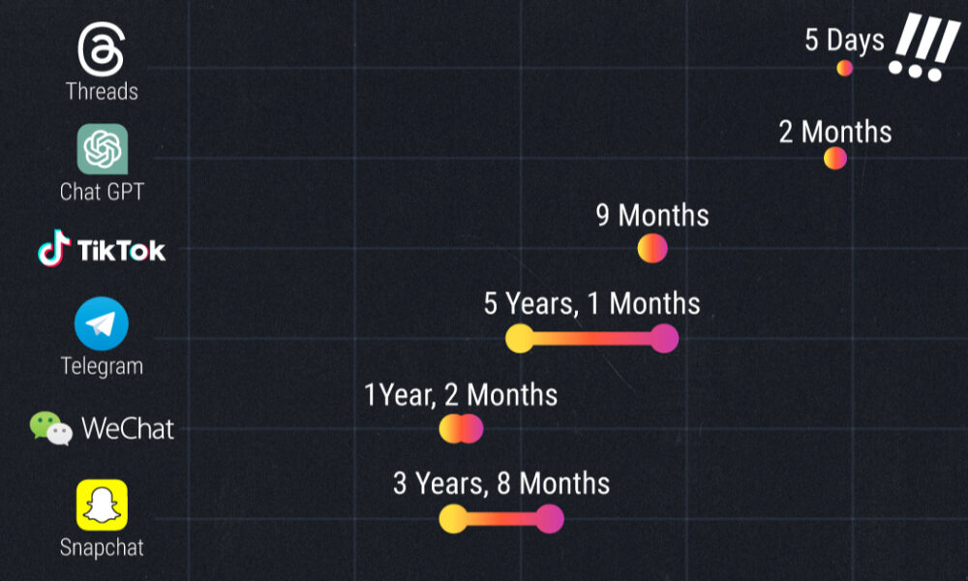
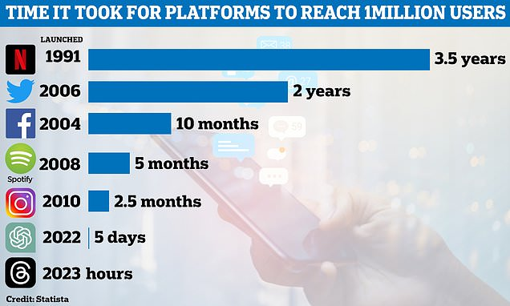
Characteristics of 4th IR

Slide 18
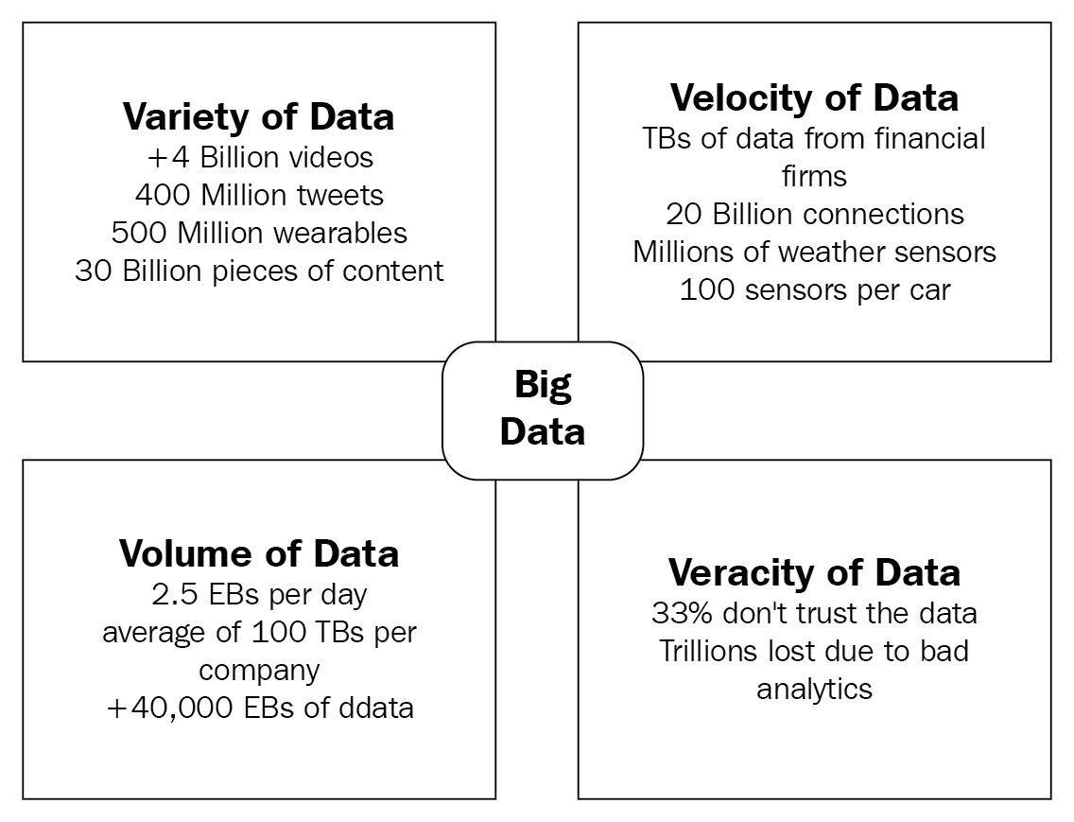
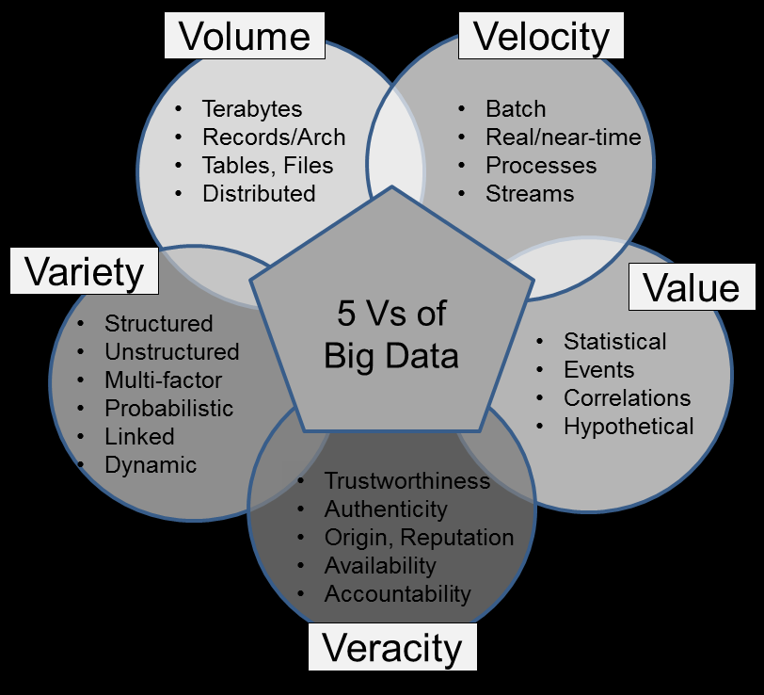
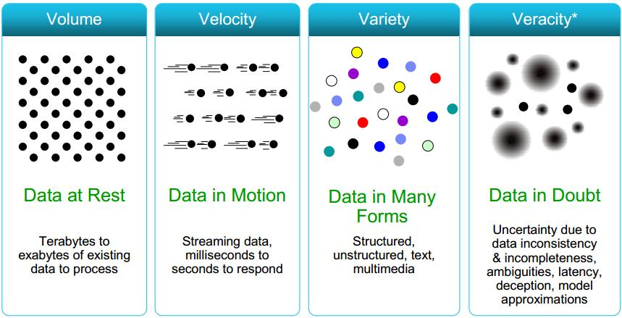
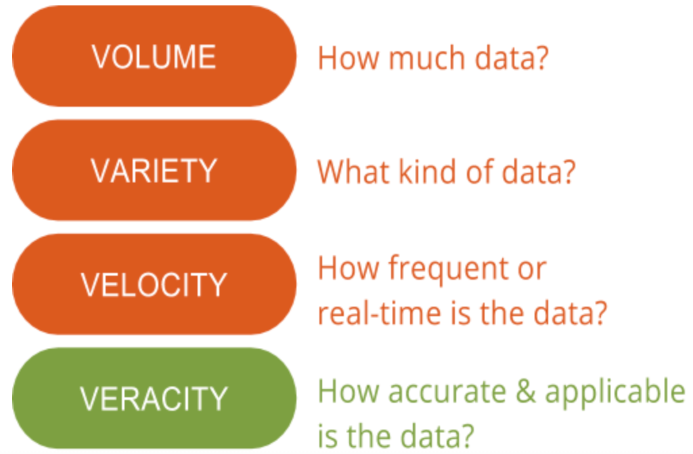
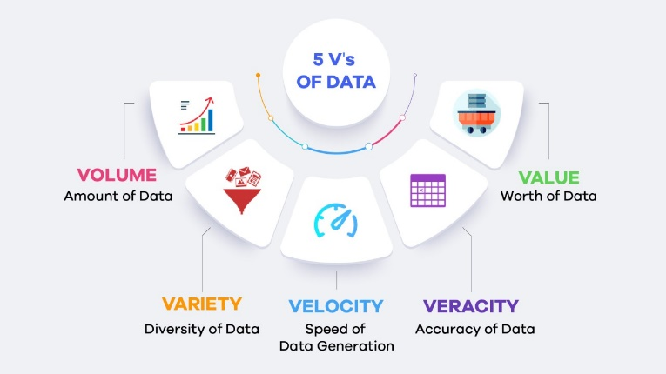
Characteristics of 4th IR

Slide 19
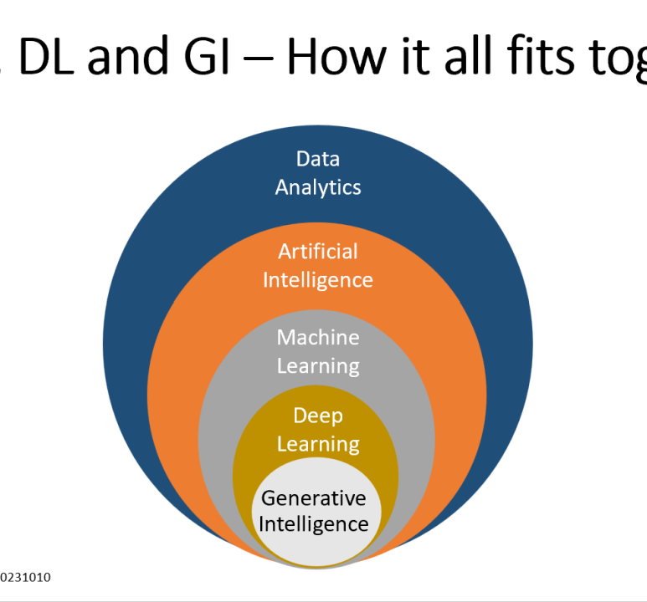
Artificial Intelligence and Machine Learning
These technologies enable machines to learn from data, make decisions, and improve over time. They are used in a wide range of applications from autonomous vehicles to personalized medicine.
https://www.linkedin.com/pulse/how-does-ai-ml-dl-gi-fit-together-anang-b-singh

Slide 20
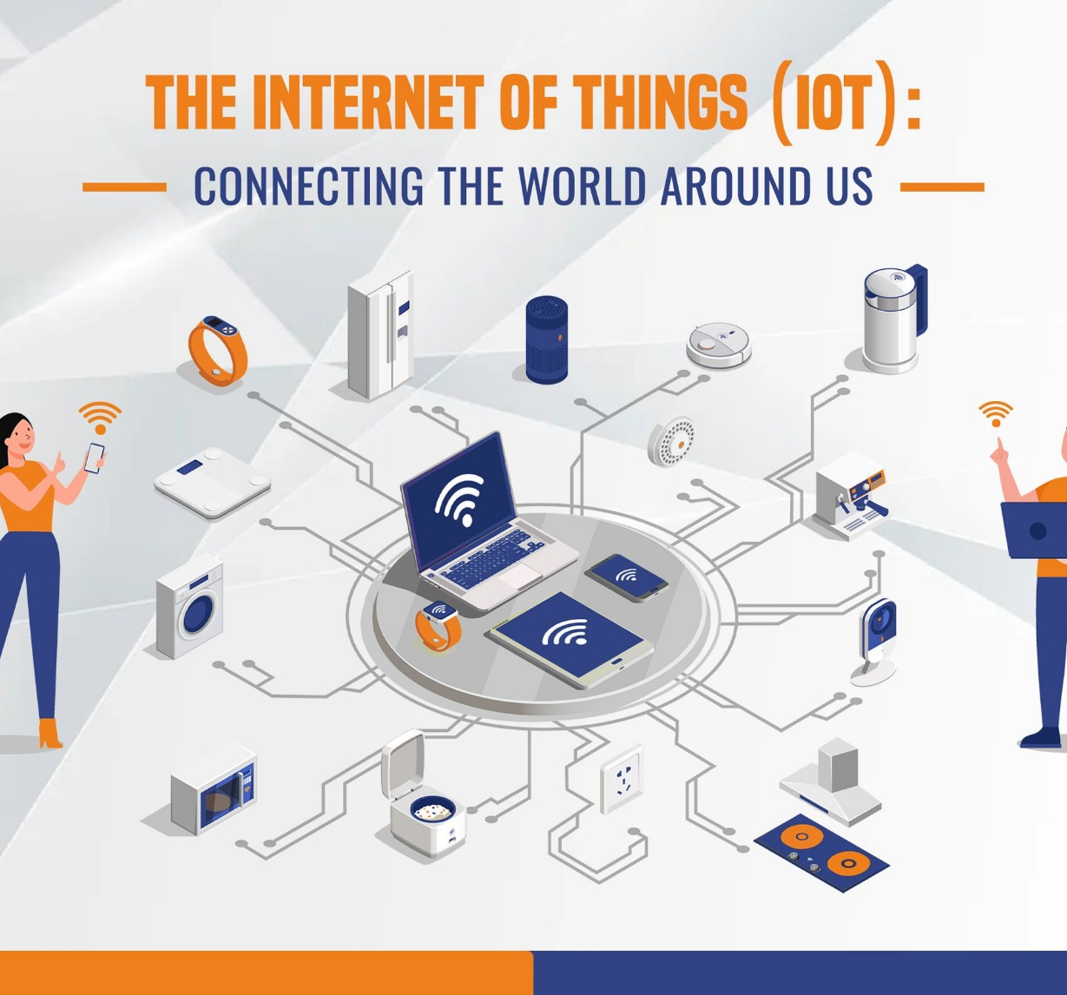
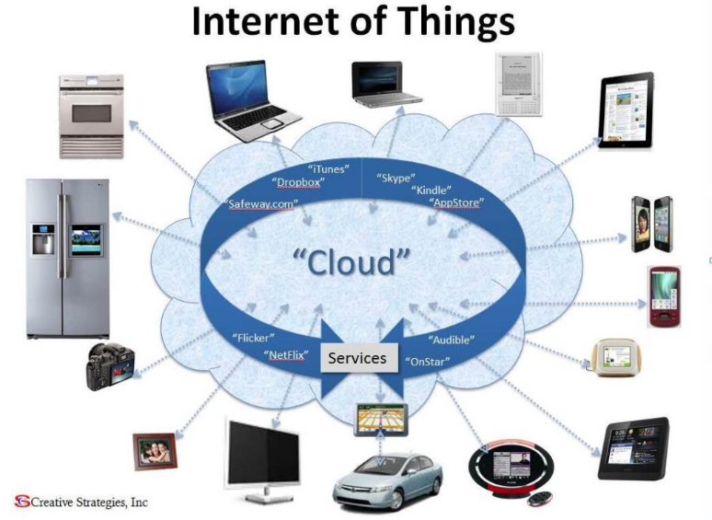
Internet of Things (IoT):
This refers to the network of interconnected devices that can communicate and exchange data with each other. IoT is used in smart homes, wearable devices, industrial automation, and more.

Slide 21
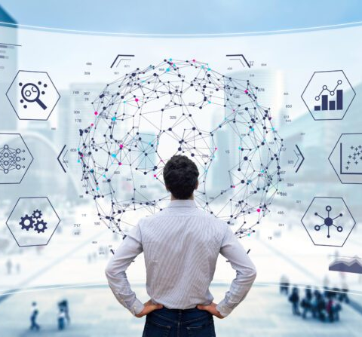
Big Data and Analytics:
The vast amounts of data generated by digital devices are analyzed to uncover patterns, trends, and insights that can inform decision-making and drive innovation.

Slide 22
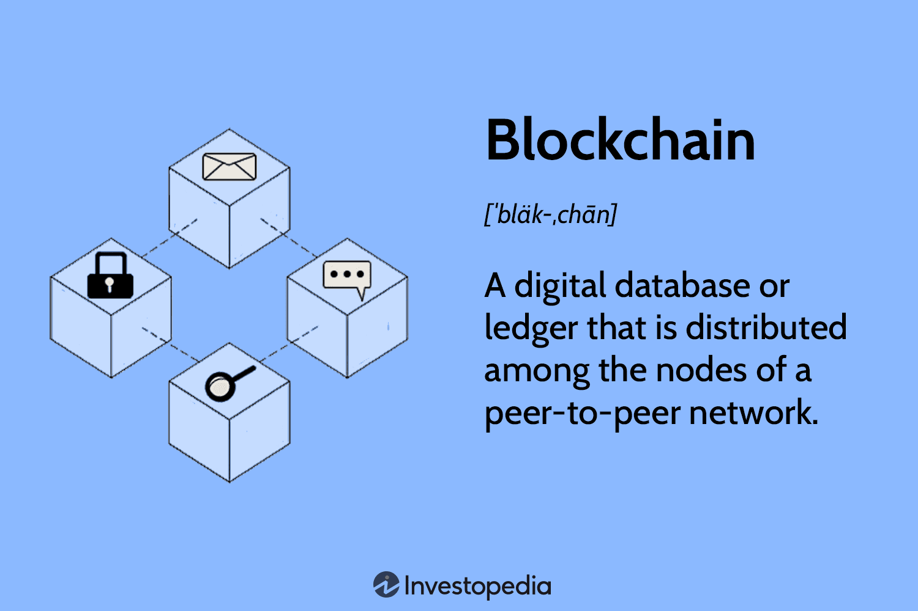
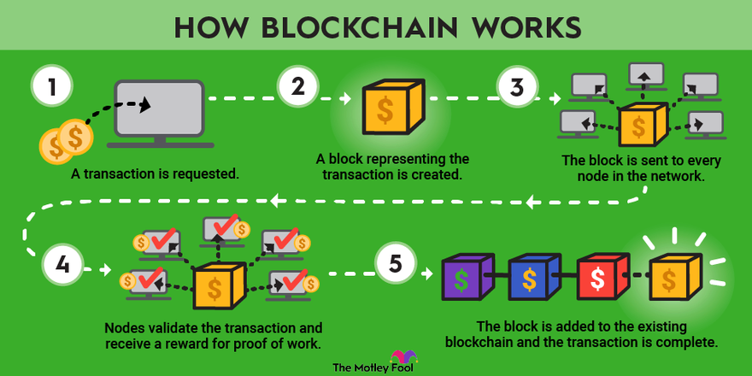
Blockchain
A decentralized and secure way of recording transactions and managing data, blockchain is used in cryptocurrencies, supply chain management, and secure voting systems.

Slide 23
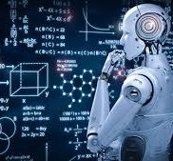
Robotics
Advances in robotics are leading to more sophisticated and capable robots that can perform complex tasks in manufacturing, healthcare, and other sectors.

Slide 24
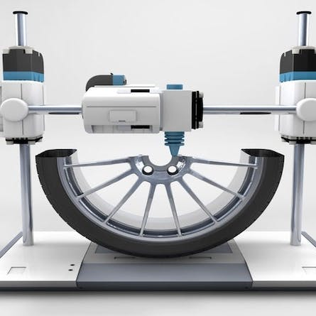
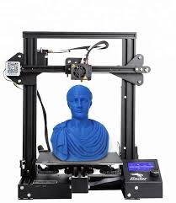
3D Printing (Additive Manufacturing)
This technology allows for the creation of complex objects by layering materials, which is used in industries like aerospace, automotive, and healthcare for customized manufacturing.

Slide 25
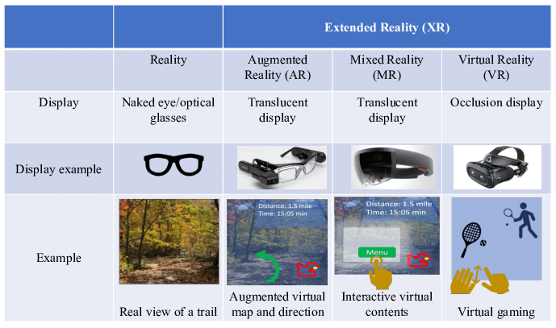
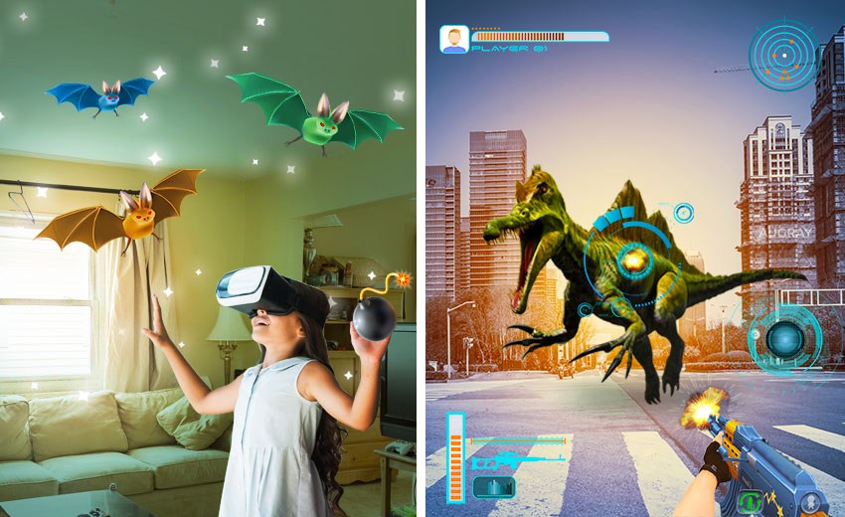
Augmented Reality (AR) and Virtual Reality (VR)
These immersive technologies are used for training, simulation, entertainment, and enhancing user experiences in various fields.

Slide 26
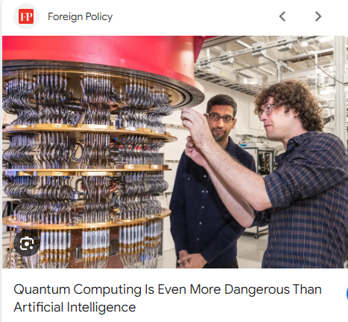
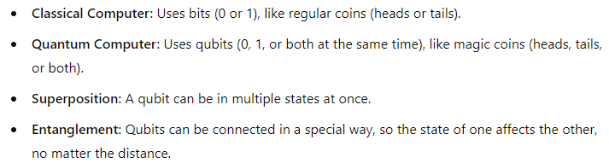
Quantum Computing
Though still in early stages, quantum computing promises to solve complex problems much faster than classical computers by leveraging the principles of quantum mechanics. Let's say you’re on a treasure hunt. There are 8 treasure chests, and only one has the treasure. A regular computer would check each chest one by one until it finds the treasure. This could take a while.
A quantum computer, with its qubits in superposition, can check all the chests at once! Because of this, it can find the treasure much faster.

Slide 27
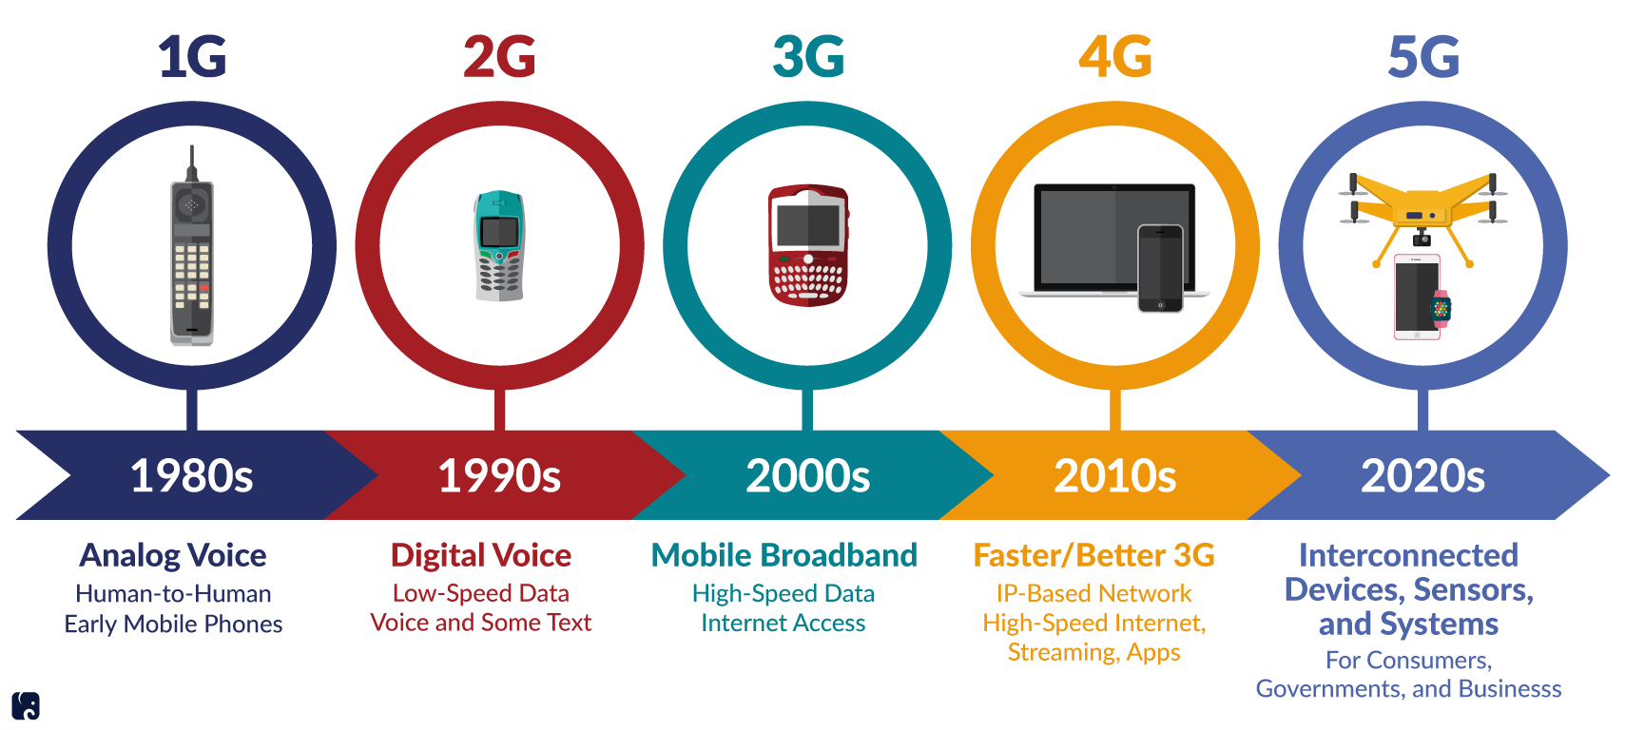
Advanced Wireless Technologies (5G and Beyond)
The next generation of wireless communication technologies provides faster, more reliable connections, enabling advancements in IoT, smart cities, and autonomous vehicles.

Slide 28
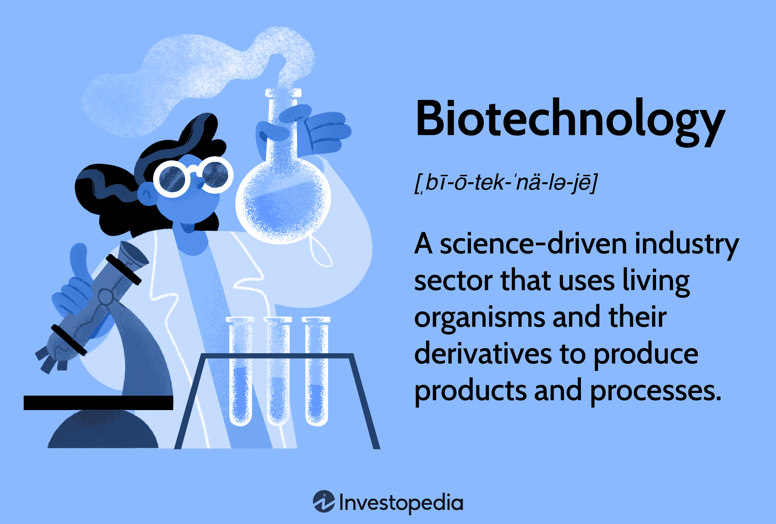
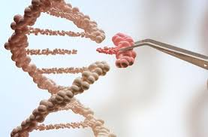
Biotechnology
Innovations in genetic engineering, CRISPR, and personalized medicine are transforming healthcare, agriculture, and other fields

Slide 29
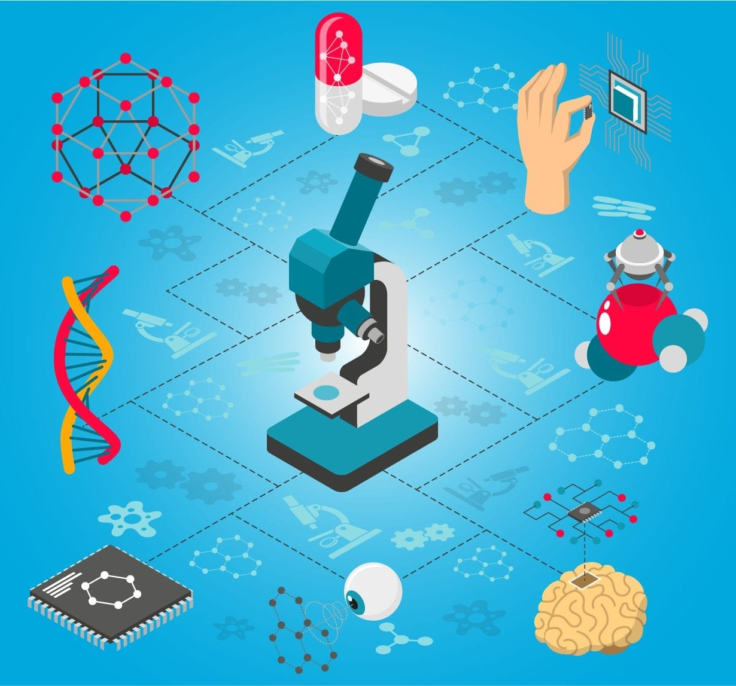
Nanotechnology
The manipulation of matter at the atomic and molecular scale is leading to breakthroughs in materials science, medicine, and electronics

Slide 30

Cybersecurity
As digital systems become more integral to all aspects of life, protecting data and infrastructure from cyber threats is increasingly critical

Slide 31
From self-driving cars to drone-delivered online shopping, the Fourth Industrial Revolution is changing how we live, work, and communicate. But with more and more jobs being taken over by artificial intelligence, what do researchers/students today need to do to stay relevant for future challenges?

Slide 32
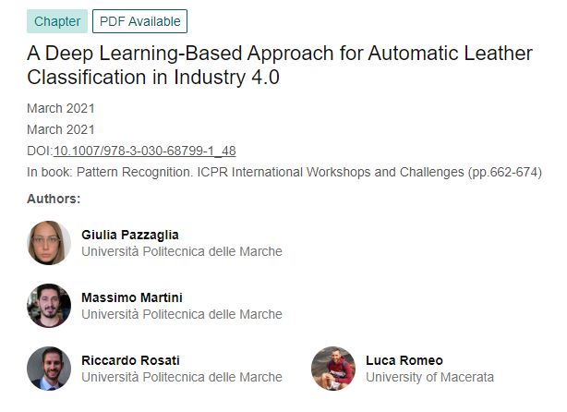
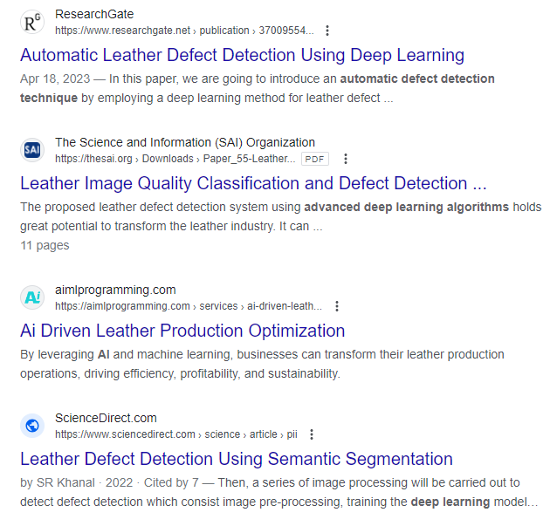

Slide 33
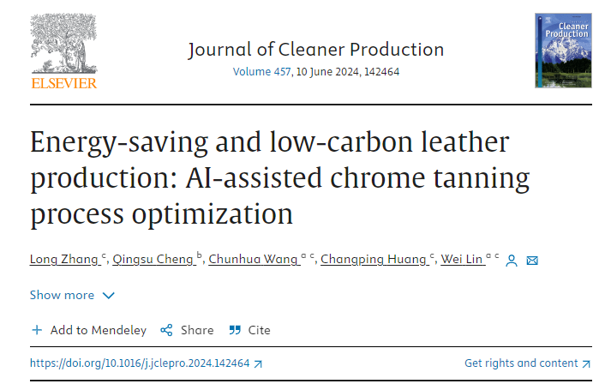
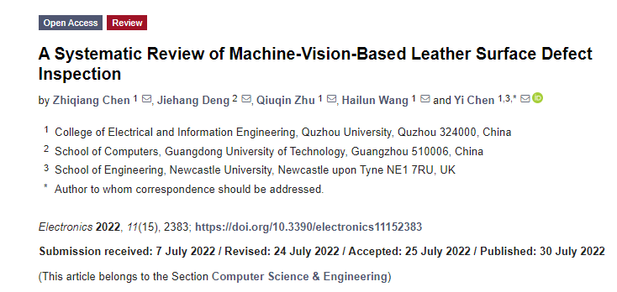

Slide 34




بِسْمِ اللهِ الرَّحْمٰنِ الرَّحِيْمِ “
In the name of Allah, the Most Gracious, the Most Merciful
Revolutionizing Flood Monitoring: A Web-Based Application
for Near-Real-Time Observation Using Satellite Imagery
Md. Imam Sohel Hossain
Senior Scientific Officer
Leather Research Institute
Bangladesh Council of Scientific and industrial Research (BCSIR)
Slide Link
App Link
BCSIR Congress-2023: Smart Bangladesh of Tomorrow is the Science of Today

Slide 35
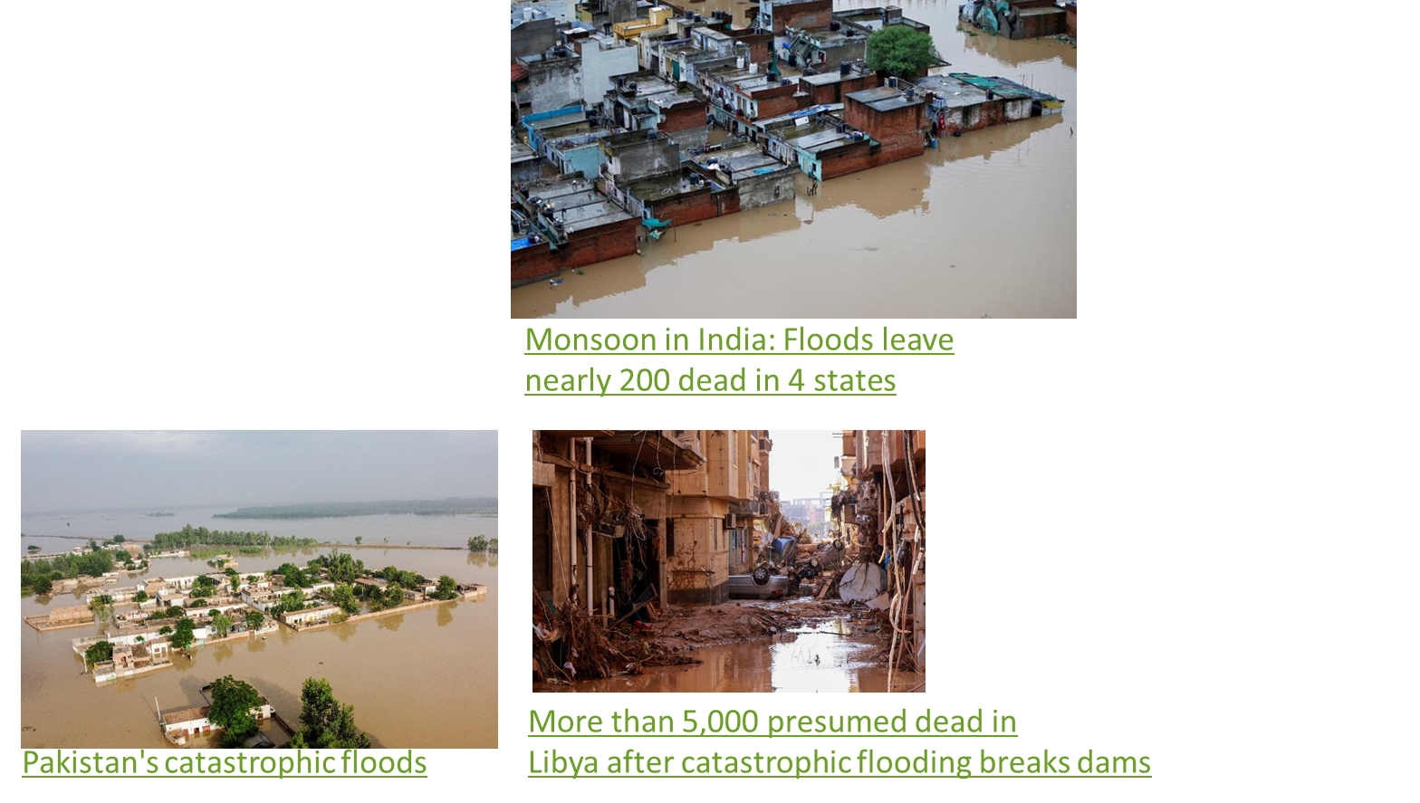

Background
Problems
World scenario-Pakistan, India, Libiya¹
Bangladesh overview regarding latest researches²³⁴
1. Portalés-Julià et al., 2023. https://doi.org/10.1038/s41598-023-47595-7
2. Lal et al., 2020. https://doi.org/10.1007/s11069-020-04233-z
3. Mrinal et al., 2020. https://doi.org/10.1016/j.isprsjprs.2020.06.011
4. Pandey et al., 2022. https://doi.org/10.3390/su14074210

Slide 36
Research gap with respect to critical analysis of literatures
Voluminous dataset store and analysis are tough in conventional way
In fact, traditional analysis is done by trained analysts on high powered computers, which can create a resource barrier for fiscally strained communities or those without advanced training
Moreover, flood monitoring in field based is expensive as well as time consuming
Readily observable field evidence of the largest or most recent natural disasters are difficult
For example, the timing and extent of a series of flooding events over many years will be difficult and expensive to determine with field methods alone
Apart from that field-verified inventories of spatially extensive events may take many months

Slide 37
Research Opportunity
Big Data
Cloud Storage
Flood
Monitoring
Parallel Computing

Slide 38

Research Opportunity
Game Changer-Google Earth Engine is a remote sensing data analysis platform designed to take advantage of Google’s infrastructure for data storage, access, processing, and visualization⁵
1 petabyte= 1024 TB= 1million GB
5. Gorelick et al., 2017. https://doi.org/10.1016/j.rse.2017.06.031, 2017

Slide 39
Objectives
Develop an cloud based application which could fetch data continuously from voluminous data
Fast and reproducible estimation of the damage from local to regional scale regarding flood extent, population exposed, affected cropland and urban areas
Map flooded affected areas, croplands, populations and urban areas in near real time using Sentinel-1 SAR data, the GEE cloud computing platform
Open a platform for scientists and non scientists to explore and characterize the spatial pattern of flood by making it open source. The power of parallel computing will save our time for understanding the flood dynamics and spatial pattern for predicting future hazards and eventually decision making.

Slide 40
Methodology
Satellite Images
Image Preprocessing
Mosaic (before and after flood)
Speckles Filtering
Binary Flood Extent Layer
Apply Threshold
Difference Layers
Change Detection
Flood Mapping
Exclude Areas with >5% slope
Exclude permanent water
Exclude Pixels with <4 Neighbors
Refined Flood Map
Population Density
Exposed Population
Area Calculation
Intersect Layers
Cropland (MODIS)
Affected Cropland
Area Calculation
Flood Map with Damage Assessment
Urban Areas (MODISLC)
Affected Urban Areas
Area Calculation

Slide 41

Findings-Cloud-Based App Development
https://imamsohel1991.users.earthengine.app/view/bangladesh-flood-cloud-computing
Input Variables | Definition | Example
Select area of interest | Choose an area to observe the flood condition | Sylhet, Gaibandha
Select Period Before Floods (start date, end date) | The range of date prior to the event | 01 May 2022, 15 May 2022
Select Period During Floods (start date, end date) | The range of date during the event | 16 May 2022, 30 May 2022
Calculate the result | Click to show the result
Clear map output | Click to clear the output
Dataset | Sentinel-1, Revisit time 6-12 days | Copernicus SAR(GRD) dataset

Slide 42

Findings-Regional Scale Flood Mapping and Estimation

Slide 43

Findings-Divisional Scale

Slide 44

Findings-District Scale

Slide 45

Findings-Subdistrict/Upazila Scale

Slide 46


Findings-Future Flood Mapping and Modelling

Slide 47
Discussion
We developed the App and it is designed in an effective and efficient way to analyze big data
It is designed to map local to regional level flood which is aligned with the previous researches⁷⁸
However, our app is designed to estimate fast and reproducible flood areal extent, exposed population, cropland and urban area than other studies (Key Contribution)
Open a platform for future research -Technical and non technical
Specifically, aid to understand natural disaster occurrences and their spatial pattern
Thus, increase predictive capabilities for natural hazard events
In the era of big data and cloud computing, our cloud based application will increase the pace at which researchers, policy makers can evaluate flood hazard in Bangladesh
7. Ali et al., 2018. https://doi.org/10.1109/JSTARS.2017.2787650 8. Canty et al., 2017. https://doi.org/10.2760/383579

Slide 48
Limitations and Future Research Directions
The tool only accesses datasets publicly hosted within the Google Earth Engine Data Catalog. While many researchers have the funding to pursue the use of datasets acquired on a near-daily basis (e.g., from Planet Labs, Inc.), it currently does not have a mechanism for ingesting these data⁹
Validation of estimated data sets
With all of these limitations, it is important to recognize that Google is regularly making improvements and modifications to Earth Engine. We intend to monitor these activities and update the our application as needed to develop with future changes to Earth Engine
9. Notti et al.,2018. https://doi.org/10.3390/rs10111673

Slide 49

Conclusion

Slide 50
Thank You
Slide Link
App Link

Slide 51

Skill Development

Slide 52

Python

Slide 53

Python

